Slide 1

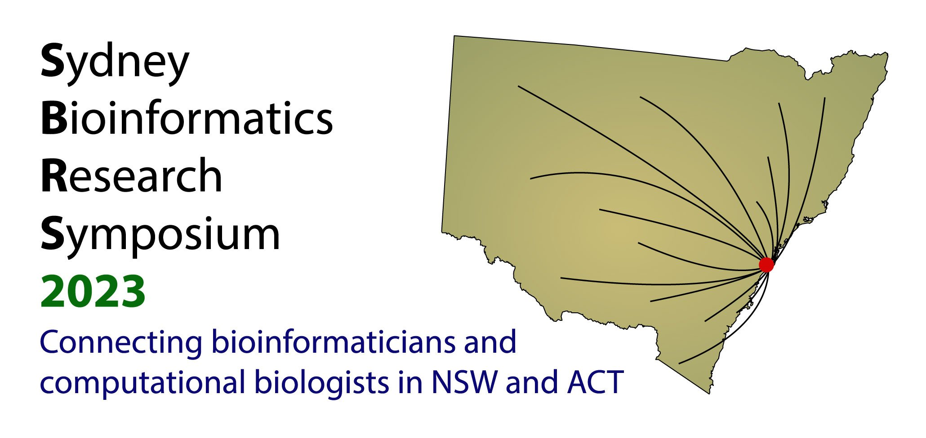

Slide 2
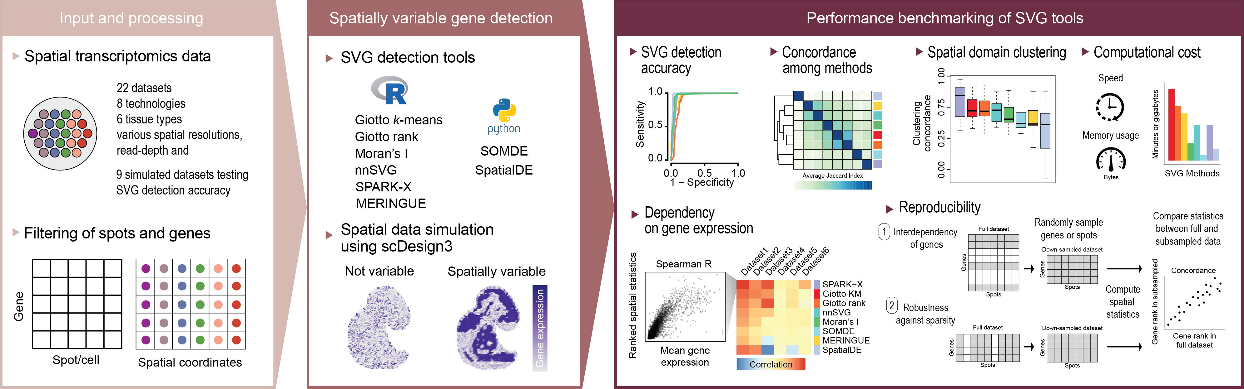

Benchmarking Spatially Variable Gene Detection Methods
Carissa Chen, Hani Kim, Pengyi Yang

Slide 3

Benchmarking Spatially Variable Gene Detection Methods
Carissa Chen, Hani Kim, Pengyi Yang
…but which method performs the best??

Slide 4
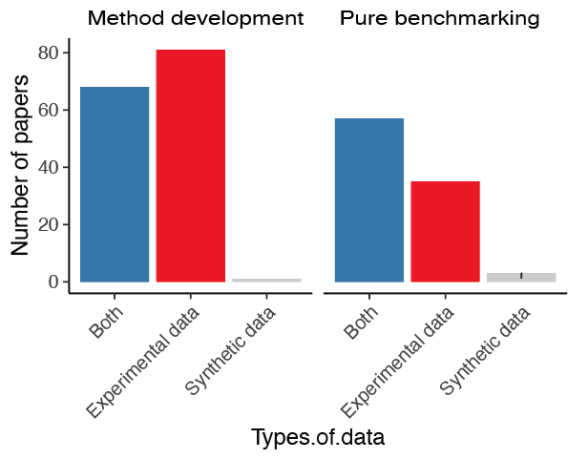
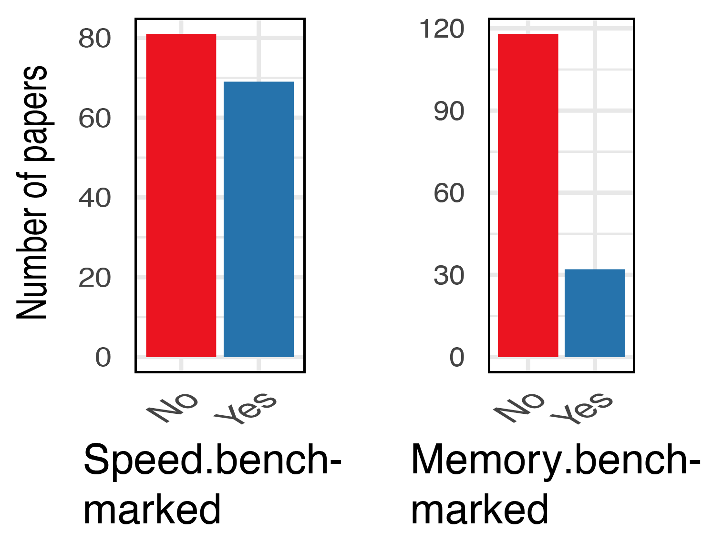
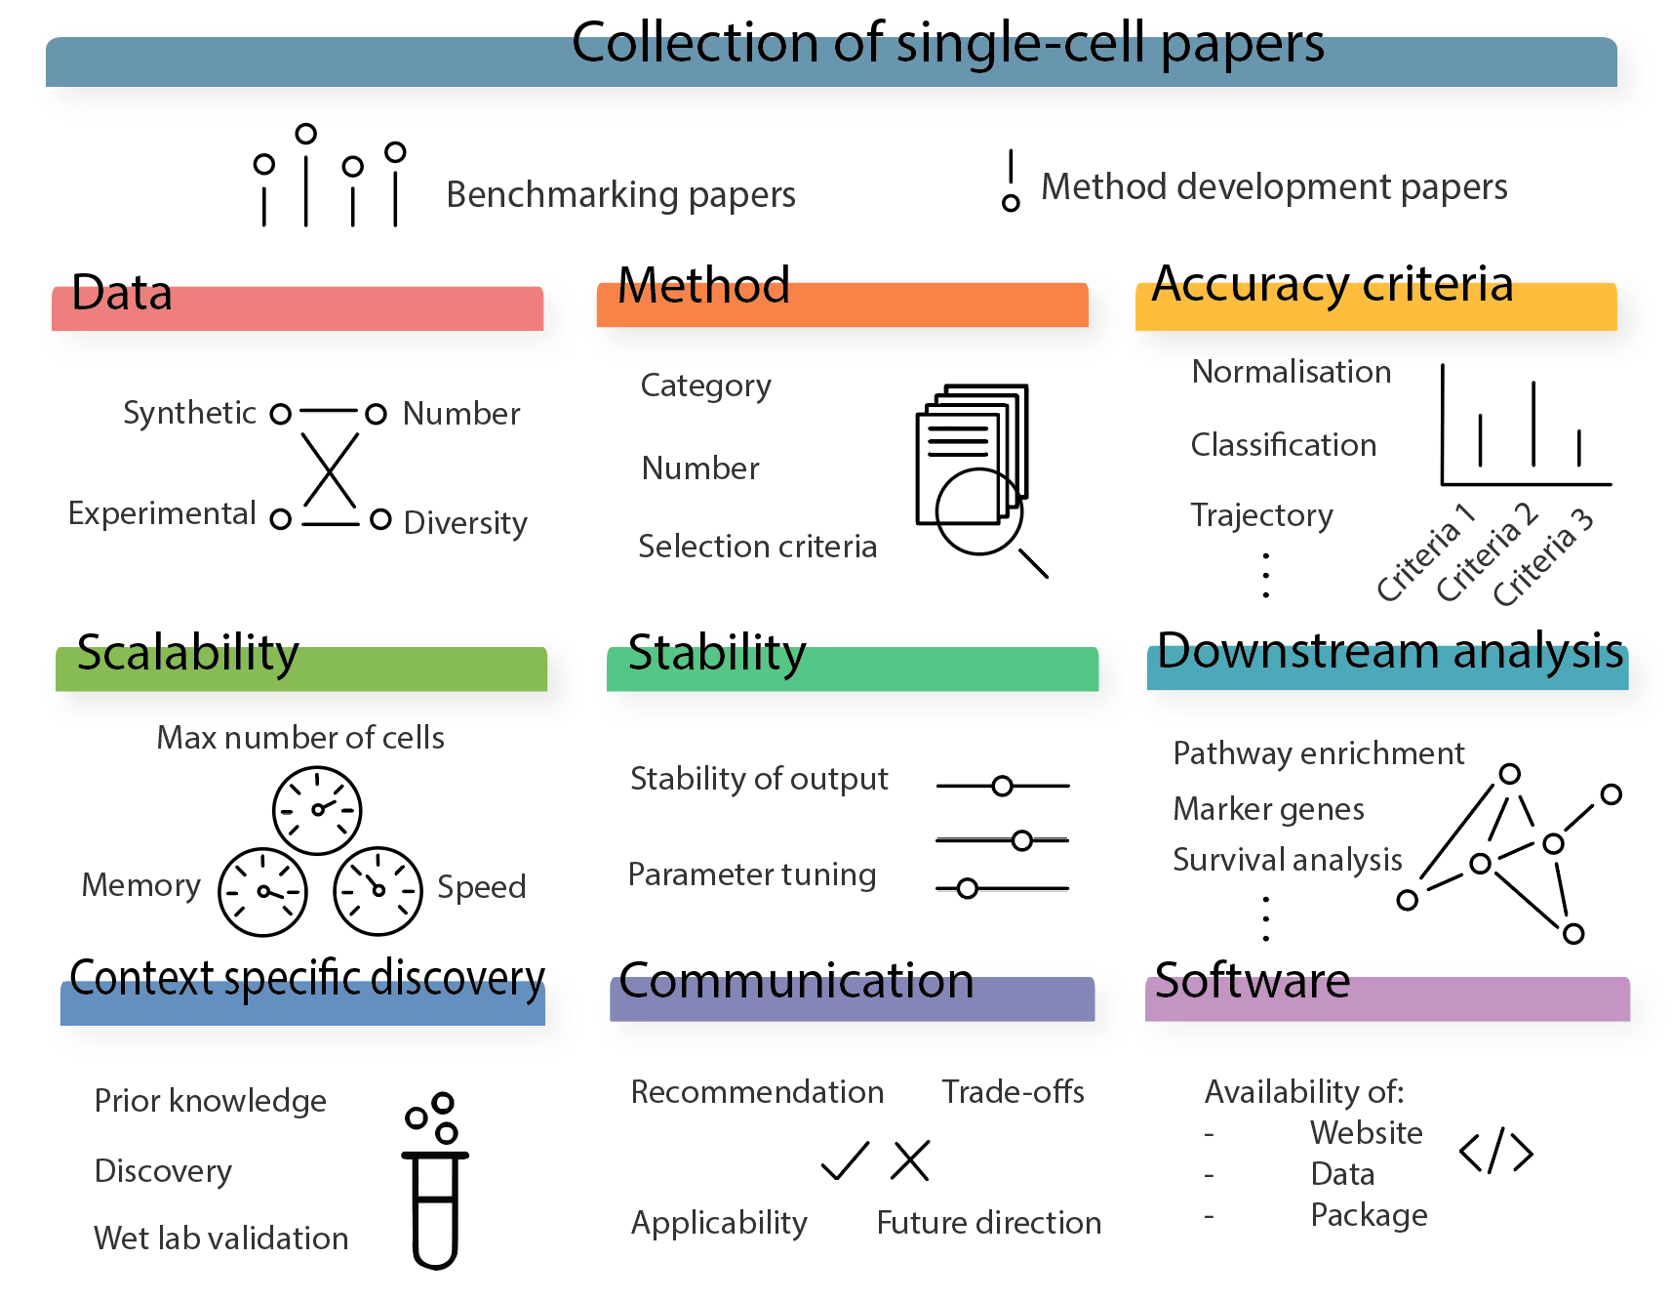
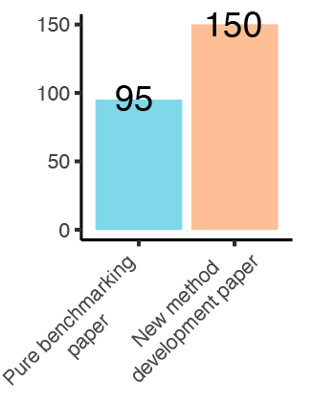
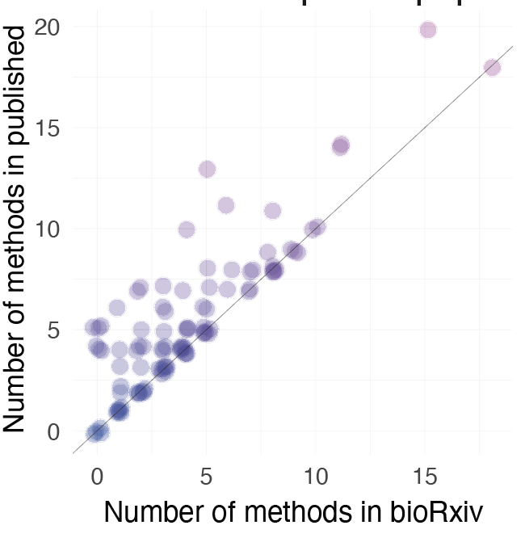
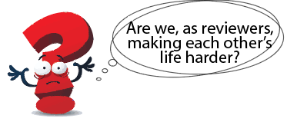
Unveiling the Complexity: The Current State of Single-Cell Benchmarking
Yue Cao ^{1,3,4+}, Lijia Yu ^{1,3,4+}, Sanghyun Kim ^{1,3,4}, Yingxin Lin ^{1,3,4}, Pengyi Yang ^{1,2,3,4*}, Terry Speed ⁵, Shila Ghazanfar, Jean Yee Hwa Yang ^{1,3,4*}
1. Collective effort to read 245 single-cell benchmarking studies
2. Assess each paper on over 70 criteria from 10 key aspects
3. Interesting findings
Only half of papers use both synthetic and experimental
People rarely benchmark memory
> 40% papers included more comparison in published version compared to bioRxiv

Slide 5
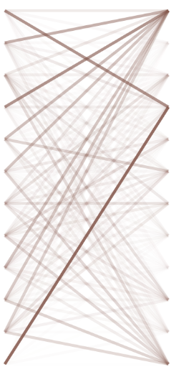
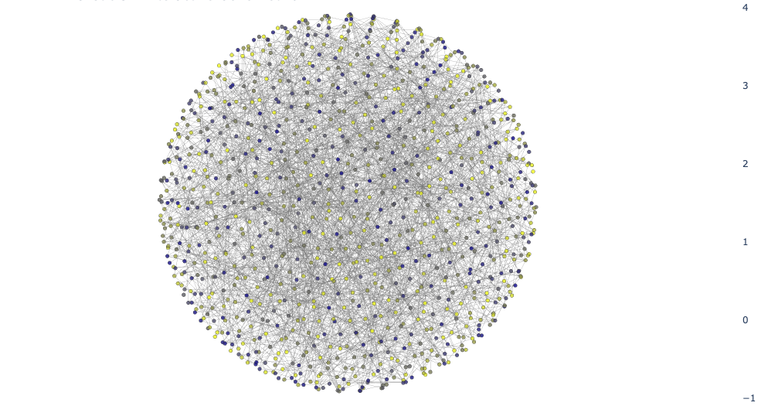
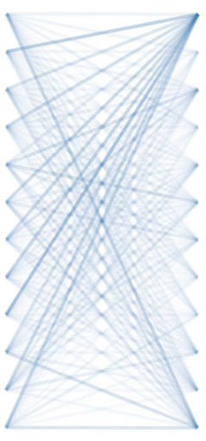
Unsupervised Deep Learning of Gene Regulatory Network from 700K Bulk RNA-seq Samples
What if we know how combination of genes causes a disease?
What if we know how to reverse a disease transcriptome?
We are building a model for the human gene regulatory network
Step 1
Pretrain a model on 700K RNA-seq samples.
Transformer Encoder
Step 2
Finetune the model using perturbation sequencing data.
?
?
?
Transcriptome of a sample
Human Gene regulatory network
Zheng Su, Marcel E. Dinger, Emily Oates, Fatemeh Vafaee

Slide 6
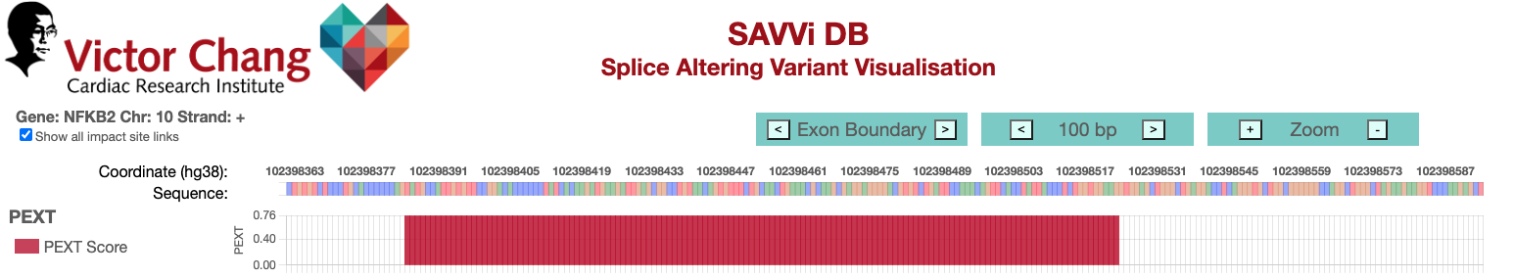
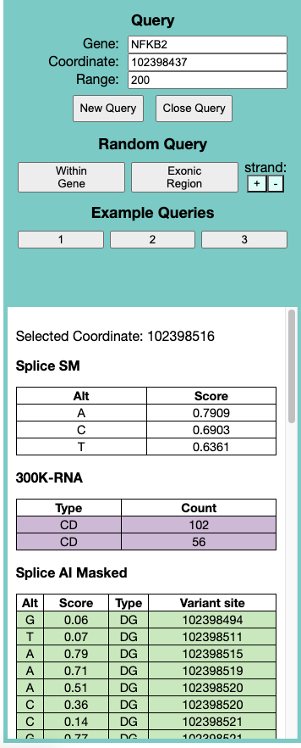
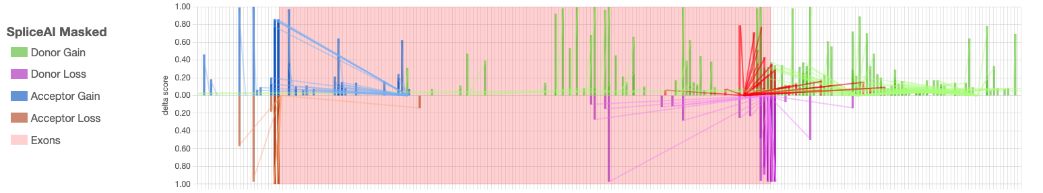
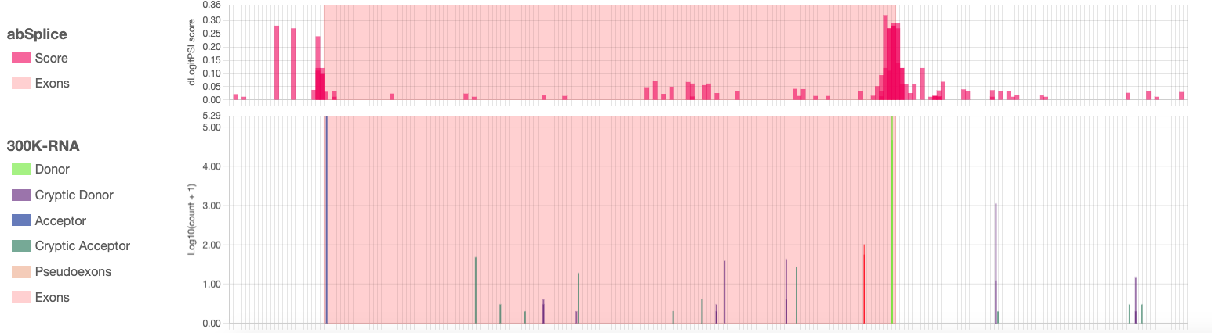
Steve Monger- Victor Chang Cardiac Research Institute

Slide 7
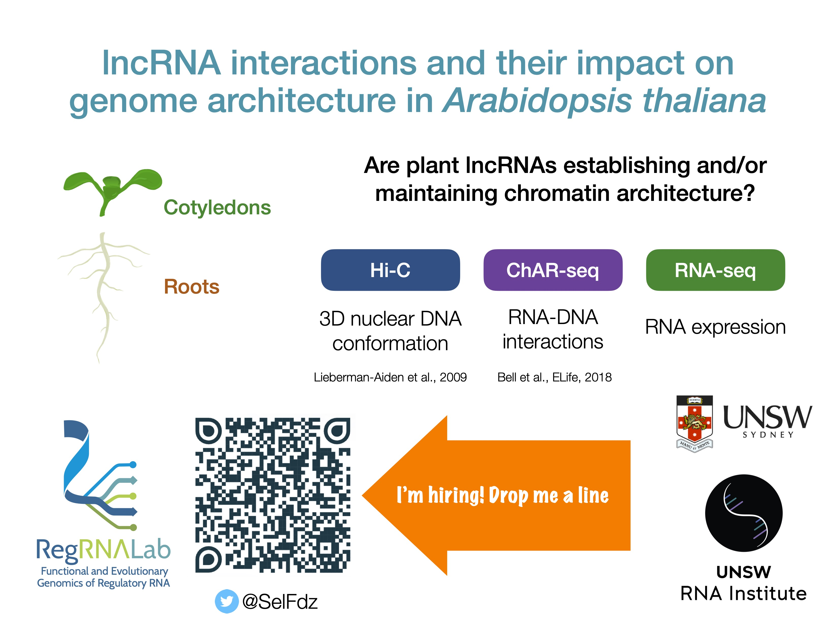

Slide 8

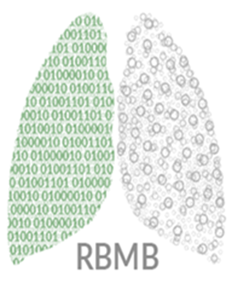
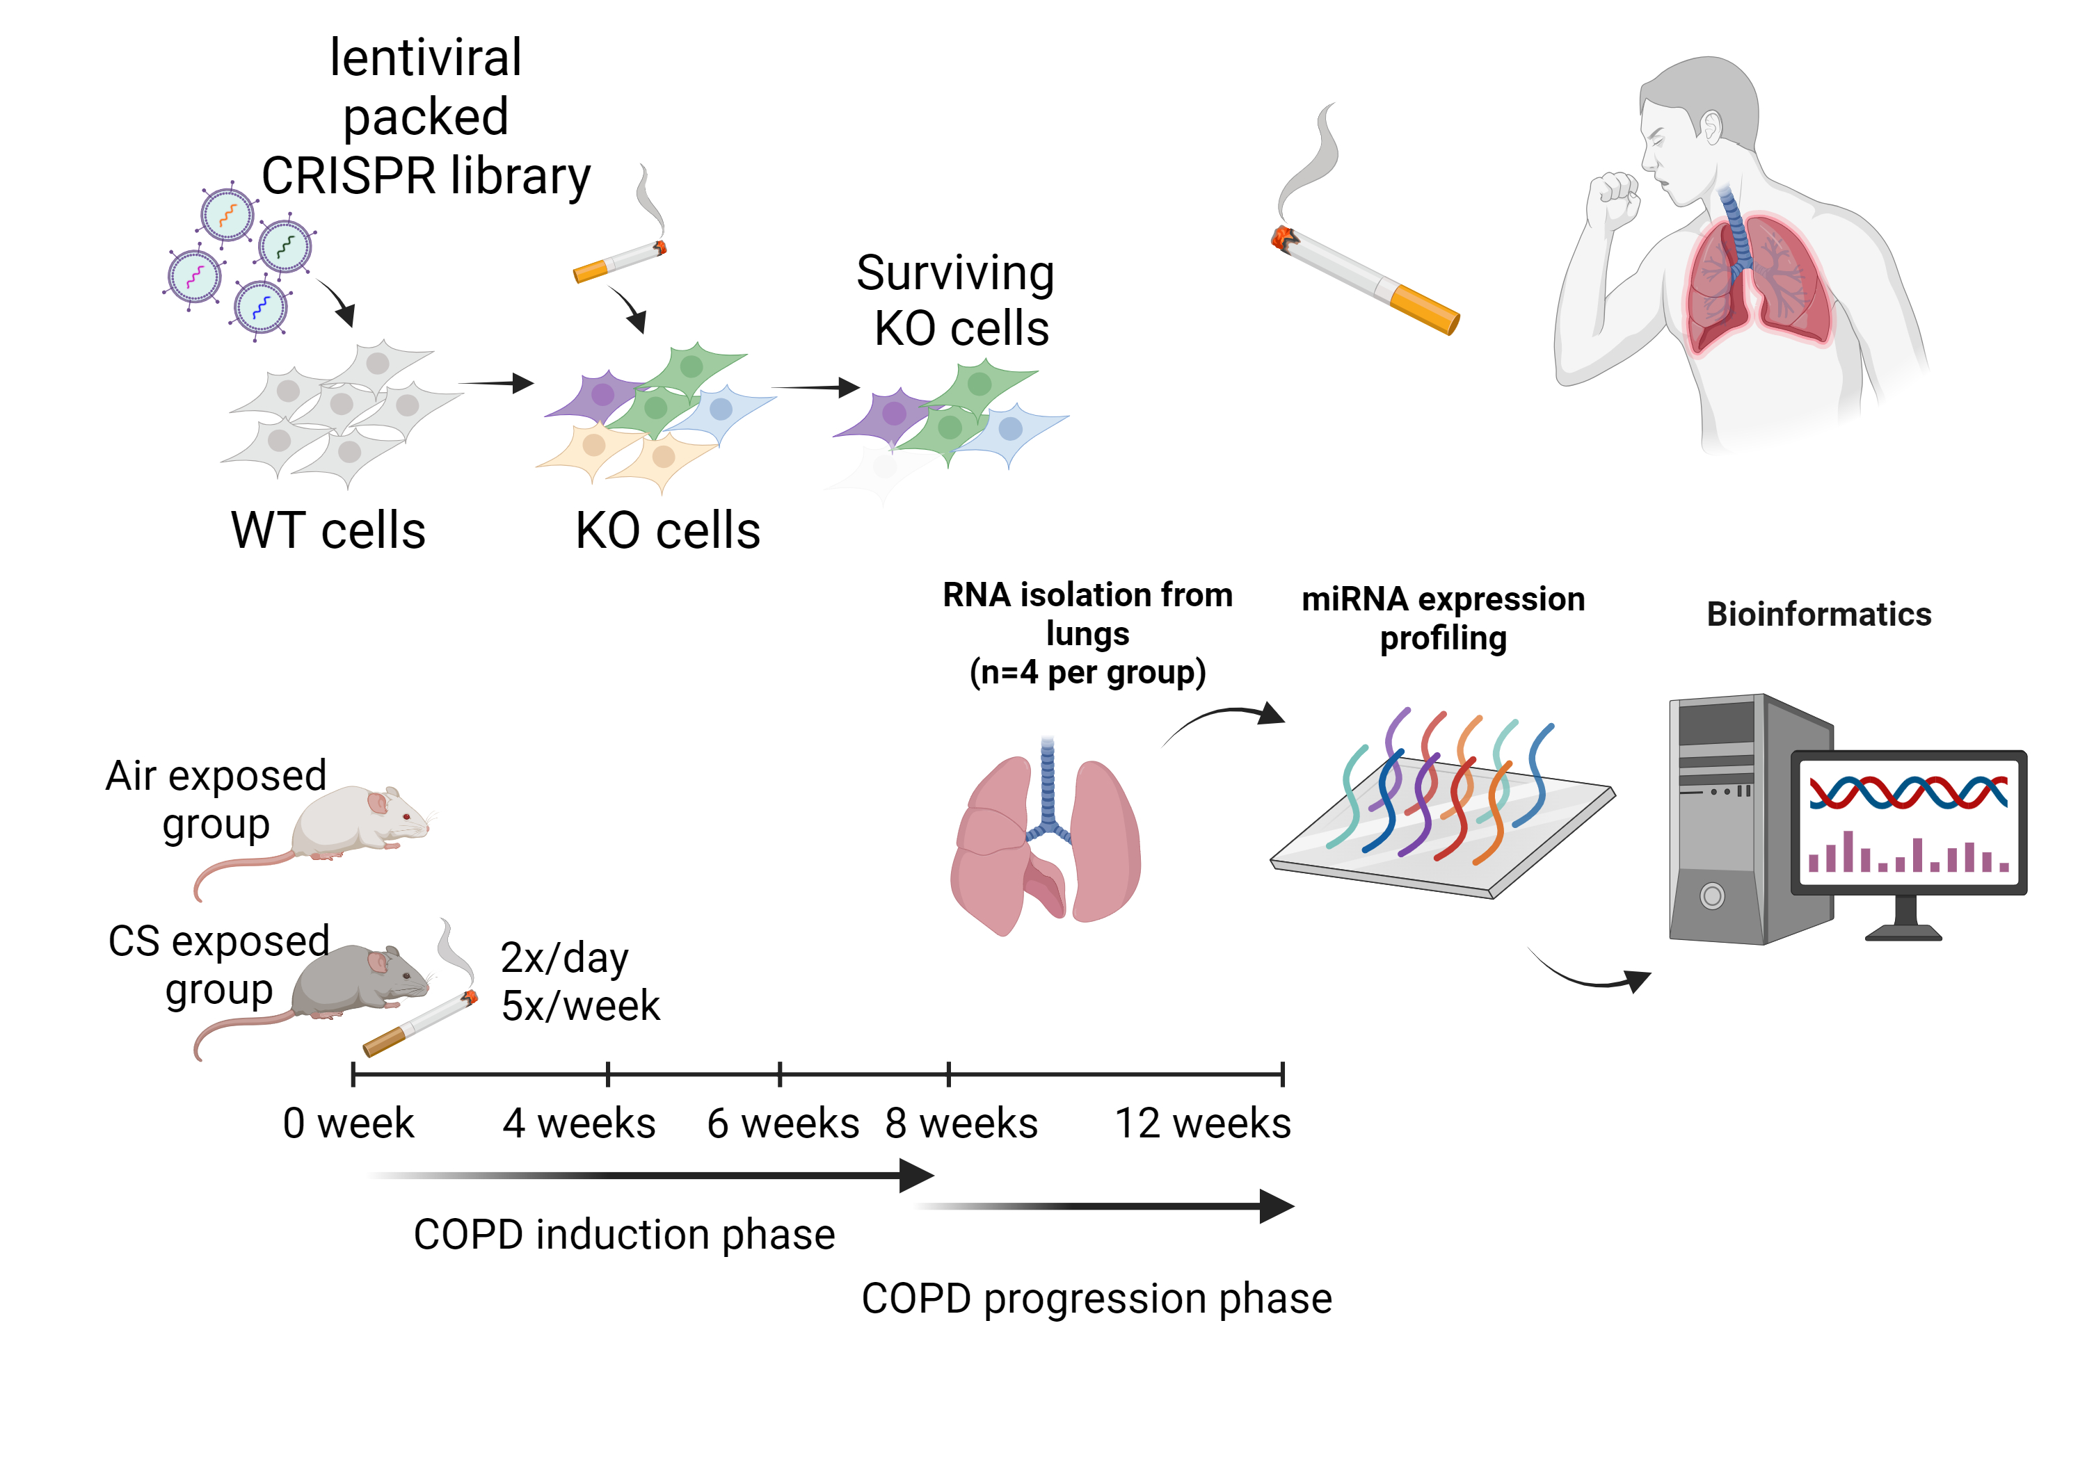
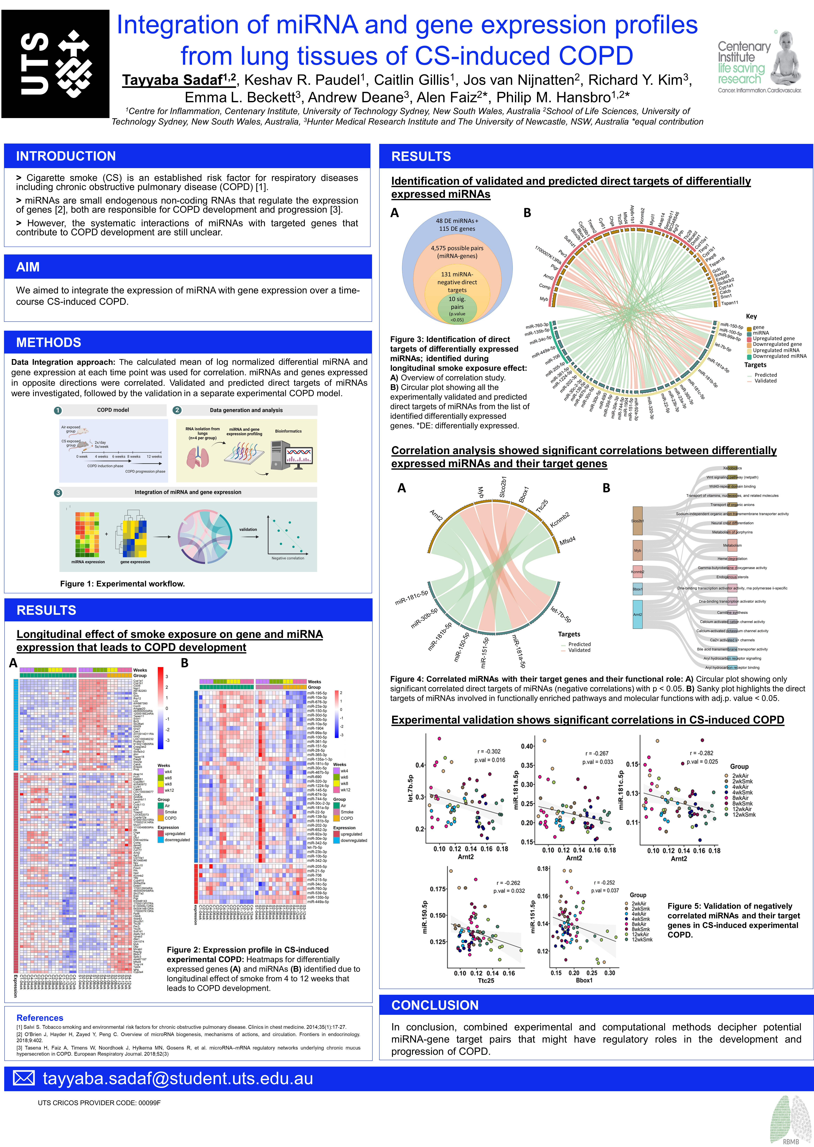
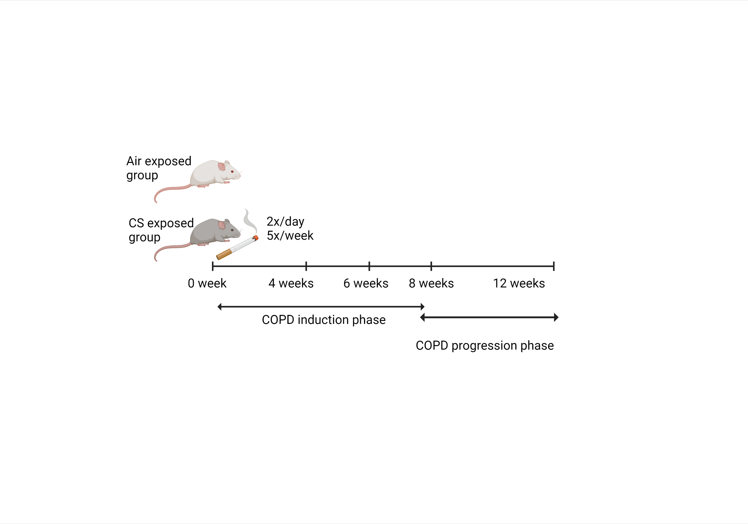
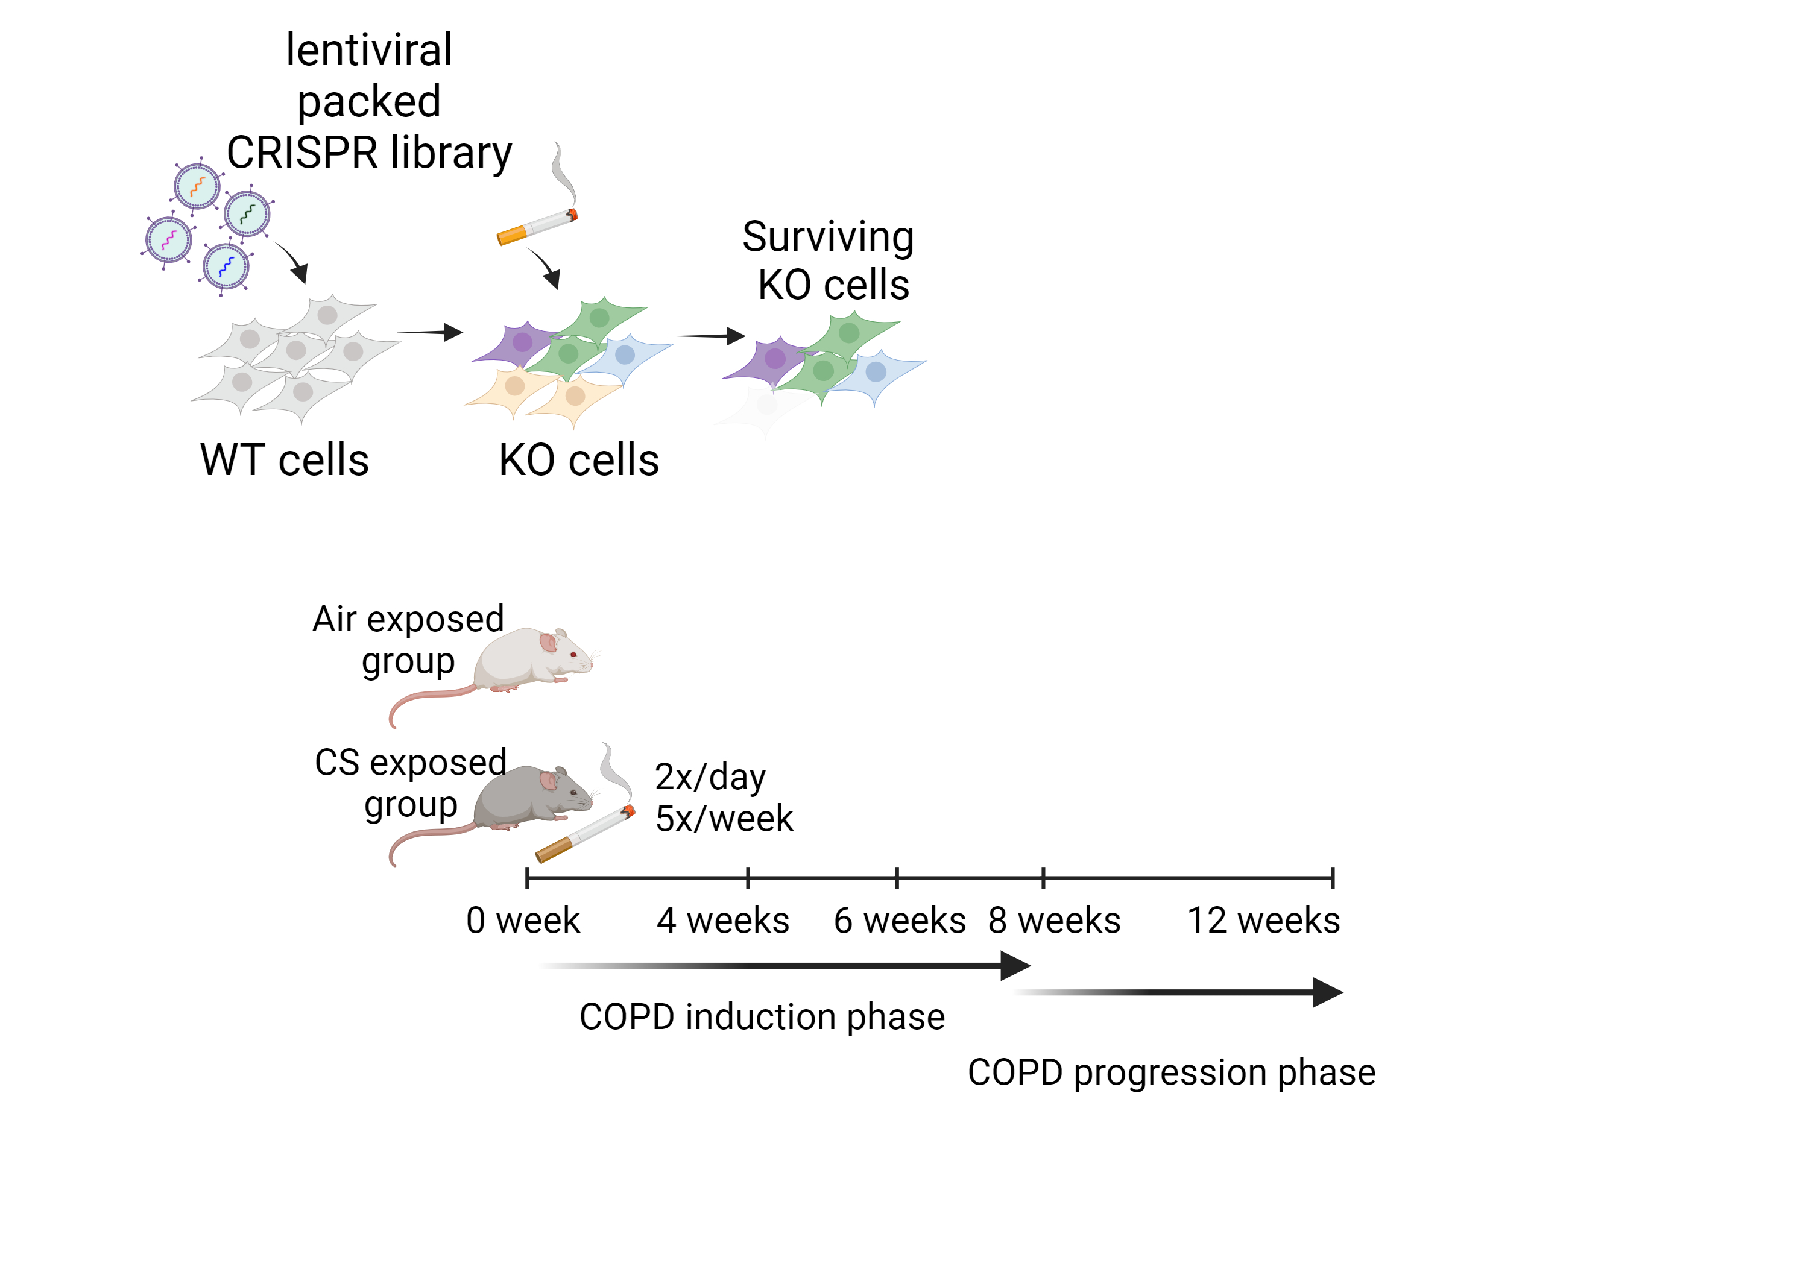
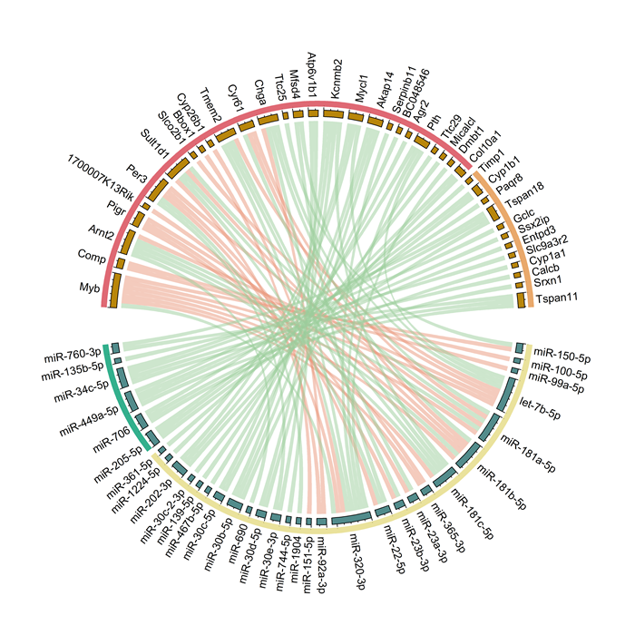
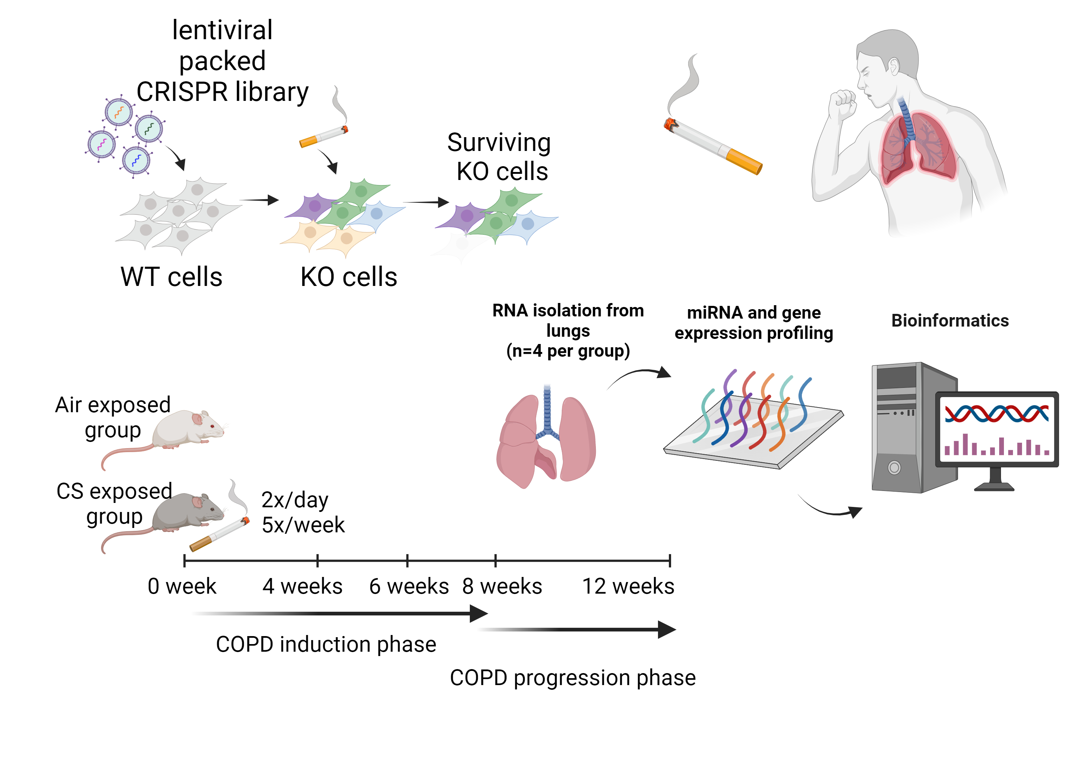

Integration of miRNA and gene expression profiles from lung tissues of CS-induced COPD Tayyaba Sadaf, Keshav R. Paudel, Caitlin Gillis, Jos van Nijnatten, Richard Y. Kim, Emma L. Beckett, Andrew Deane, Alen Faiz, Philip M. Hansbro
Chronic obstructive pulmonary disease (COPD)
Longitudinal smoke effect study
Expression validation
16

Slide 9
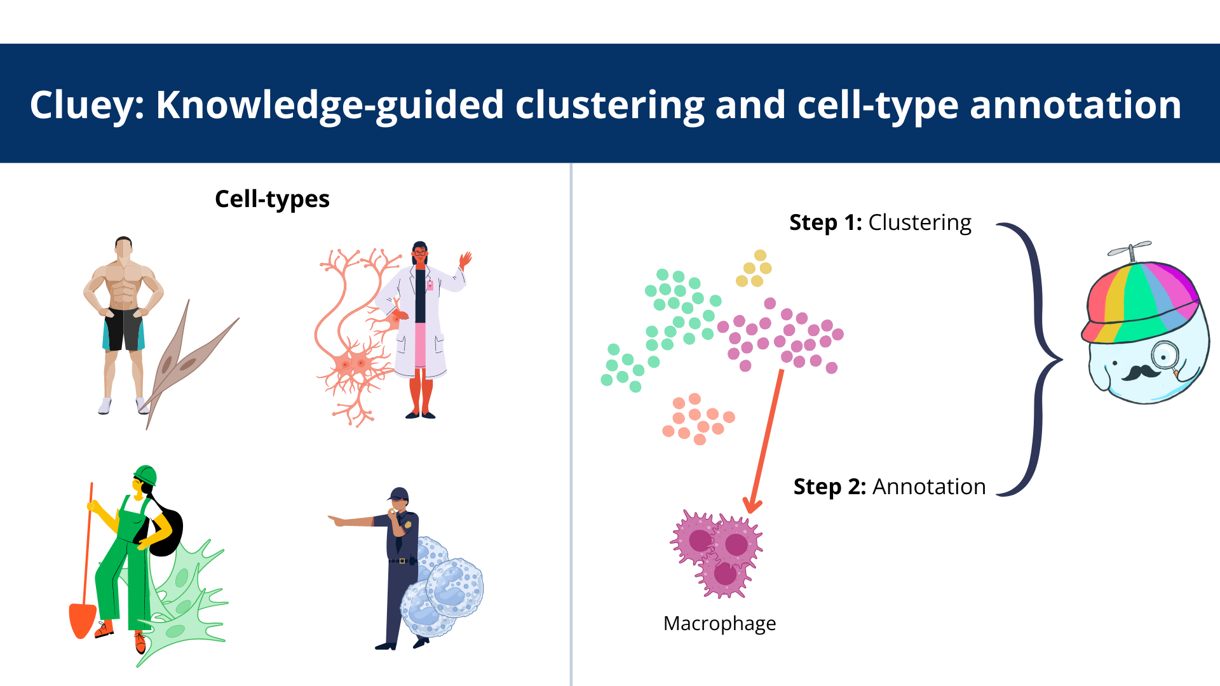

Slide 10

Random
Dispersed
Localised

Slide 11

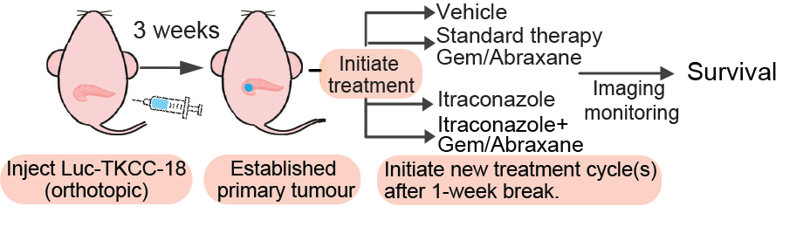
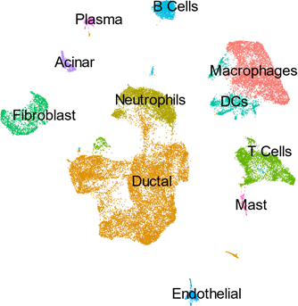
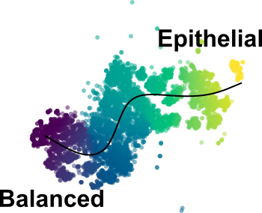

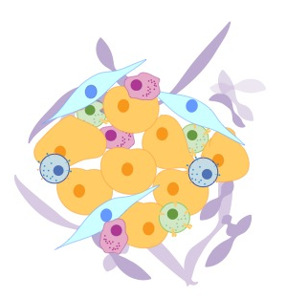
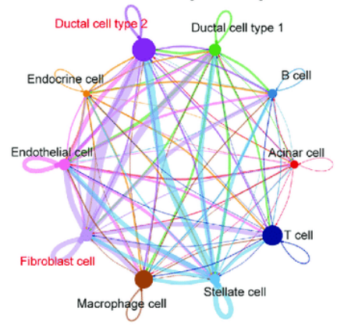
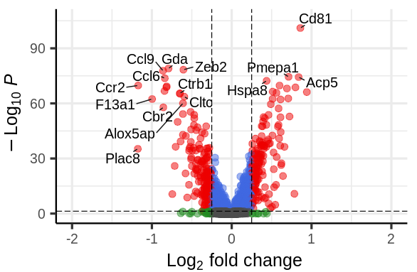
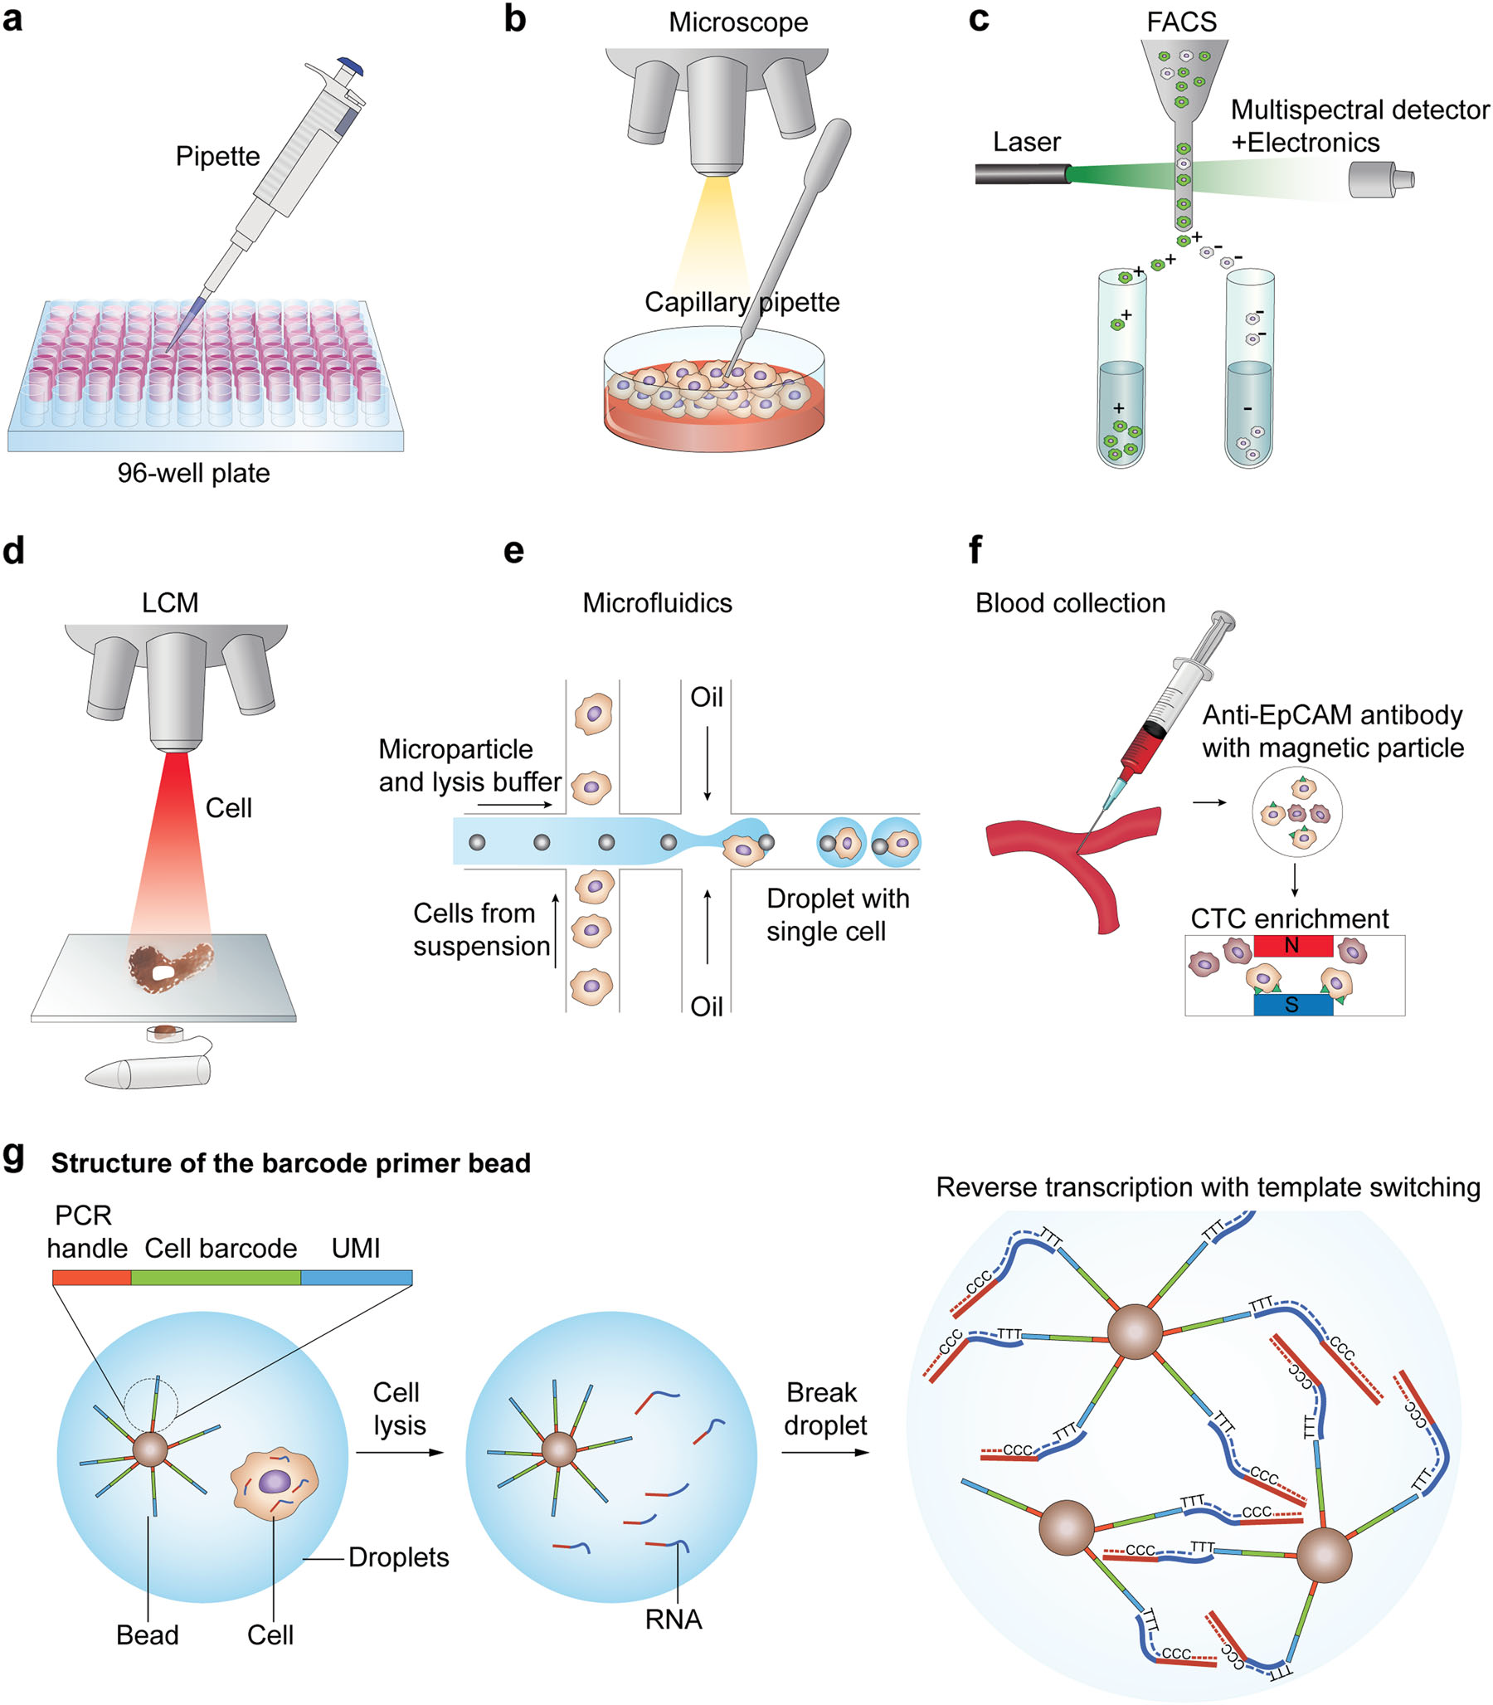

PDAC: A disease of many genotypes
Breakdown of tissue
using enzymes
Cancer
UMAP 2
UMAP 1
“Single-cell soup”
Single cell capture
Notes:
Single cell – dynamics of cancer cell – stromal interactions in response to itraconazole therapy
Characterisation of tumour-associated molecular signatures associated with response to itraconazole therapy bla bla (btw this is just text to prompt you to think – you delete this of course – only pretty pics)
Need a final big sentence, whether it’s we’re in early discussions with our oncologist collaborators about potential for Phase I (to finalise pre-clinical studies required eg next 2 years to move forward). Mayne Pharma (US biotech) have an improved bioavailability itraconazole version (SUBA-itraconazole) → which may help get Pharma sponsorship for Phase I

Slide 12
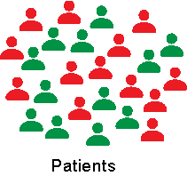
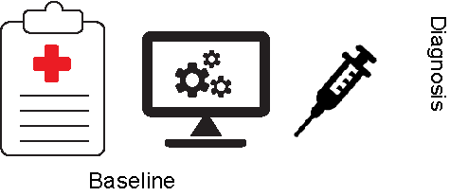
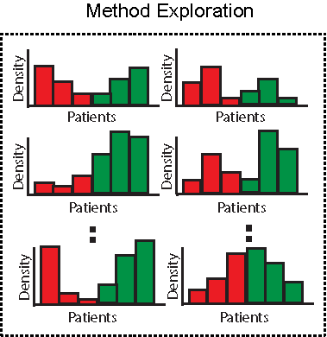
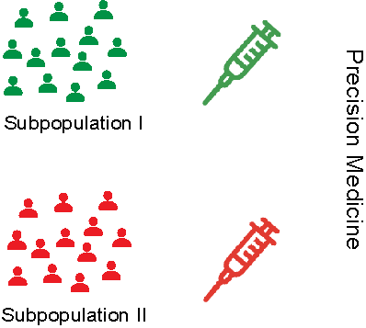


Method exploration towards precision medicine in survival data
Xiaoqi Liang, Andy Tran, Yunwei Zhang, Jean Yee Hwa Yang

Slide 13


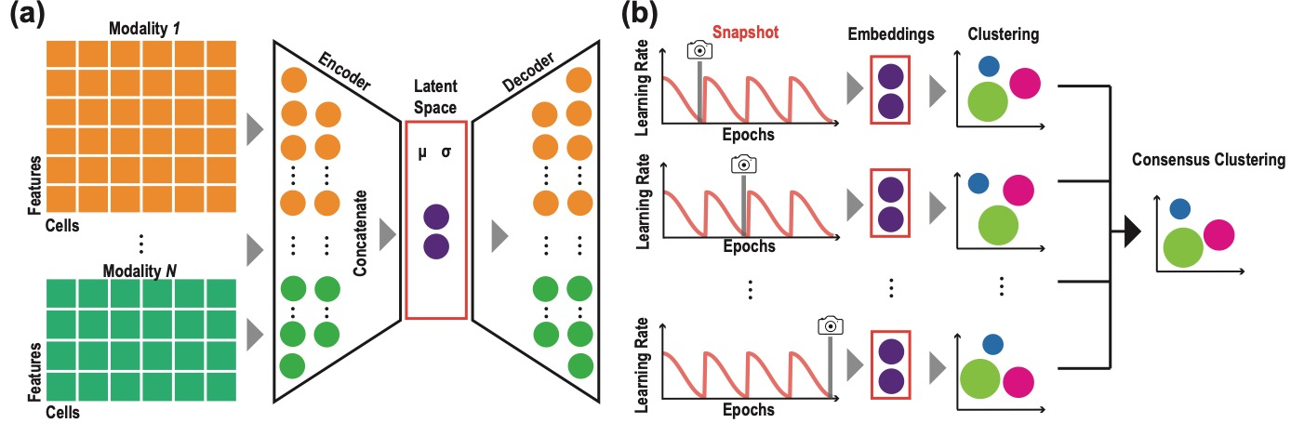
Ensemble deep learning of embeddings for clustering multimodal single-cell omics data
Lijia Yu, Chunlei Liu, Jean Y. H. Yang and Pengyi Yang
2 mins
scRNA
single clustering
scRNA
Ensemble clustering
Multimodal single cell omics
Ensemble clustering

Slide 14


Comparing methylation levels assayed in GC-rich regions with current and emerging methods
Yi Jin LIEW
WGBS, EPIC & EM-seq, ONT

Slide 15

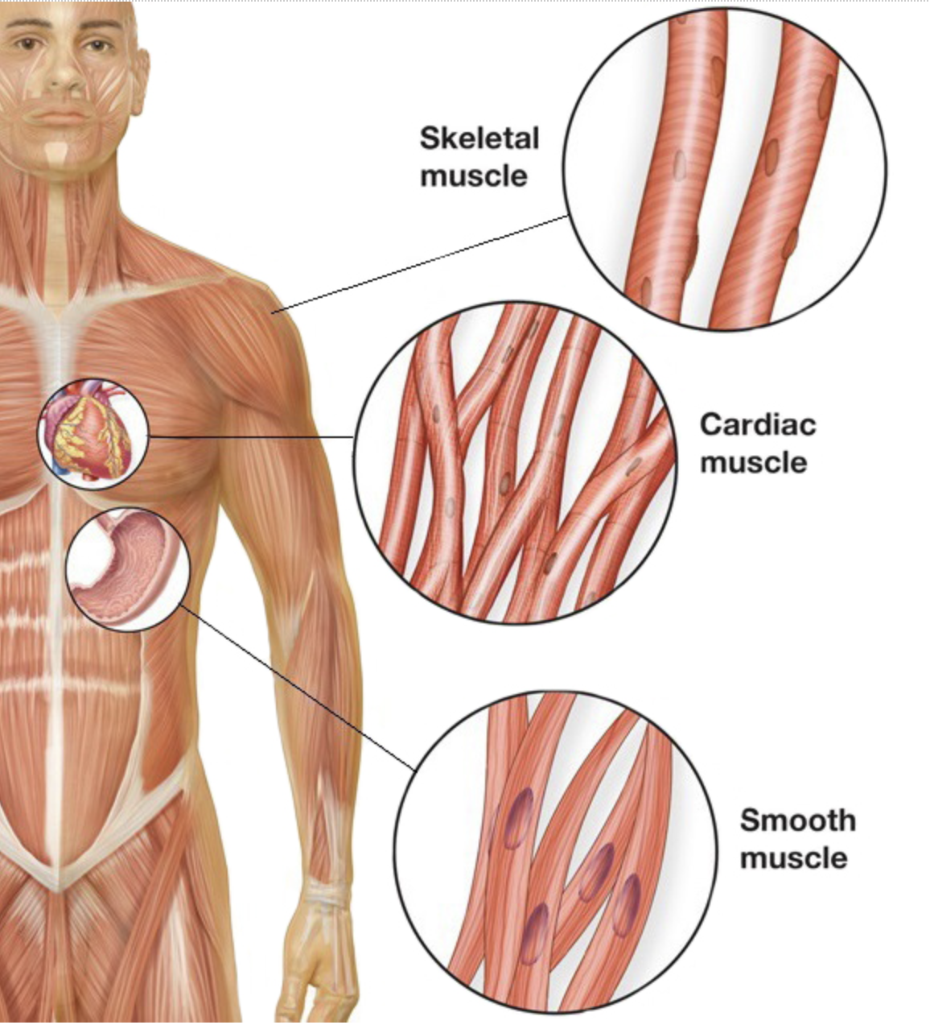




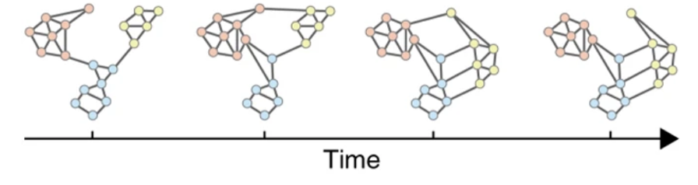

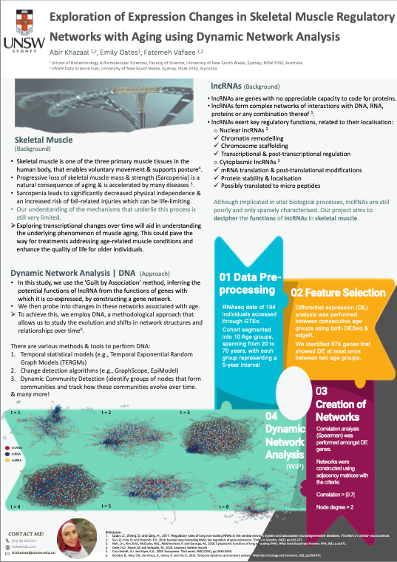
Network
Skeletal Muscle
Dynamic Network Analysis
Long non-coding RNA (lncRNA)
Exploration of Expression Changes in Skeletal Muscle Regulatory Networks with Aging using Dynamic Network Analysis
Notes:
Skeletal muscle is one of the three primary muscle tissues in the human body, that enables voluntary movement & supports posture.
Its degeneration is a natural consequence of aging… We all know that muscles become weaker with time, but our understanding of the molecular mechanisms that underlie this process is still very limited..
So, if I were to take a closer look, I am really interested in the genetic regulation that’s driving those changes... Particularly any regulatory roles exerted by lncRNAs
Why lncRNAs?
Well, lncRNAs have been named for their incapability to code for proteins in comparison to mRNAs.. Despite a significant body of evidence showing their involvement in many diseases such as cancer, cardiovascular diseases & many more.., they are still poorly & only sparsely characterised and their role in context of muscle degeneration has been overlooked!
So, If you wanted to get to know someone & to get information about them, but were unable to talk to them directly, what would you do? Well, some may argue that you would probably observe them, check their surroundings, the people they talk to and their network in general, right?
Well, this is exactly what I’ll be using. In my study, I want to create a gene regulatory network to infer the functions of lncRNAs within muscles. But these networks are not static, most real-like networks are dynamic & change over time… therefore, I want to explore the changes within these networks that are associated with time
How am I going to do that … by using a methodological approach, that has a longer history in the study of social networks but Only more recently, has been adopted for genetic networks. Encompassing a broad range of methods & tools that allows us to study the evolution & shifts in network structures & relationships over time, named dynamic network analysis.

Slide 16
